Slide 1
Recommender Systems

Slide 2



Before e-commerce

Slide 3

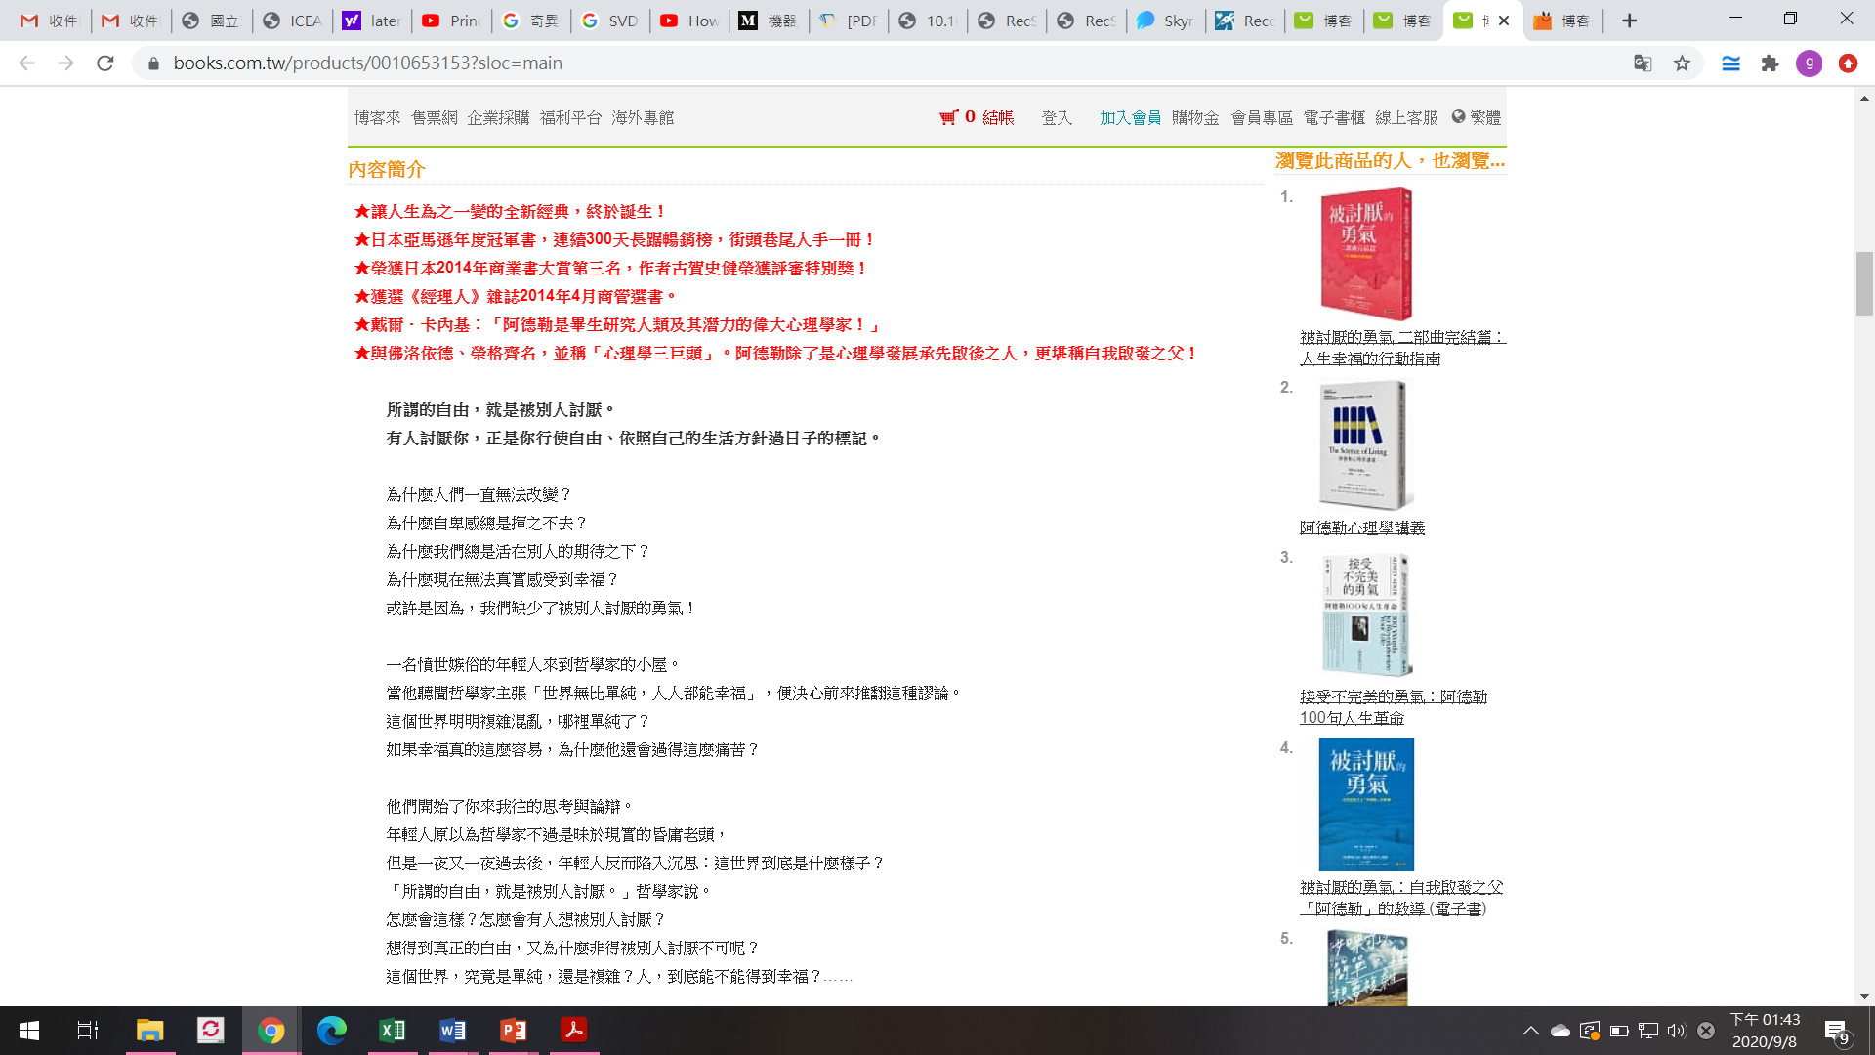
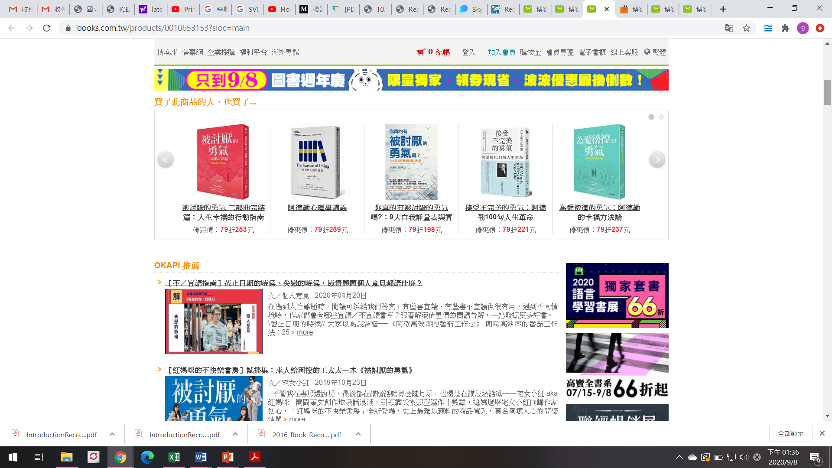

Slide 4



Problem domain
Recommendation systems (RS) help to match users with items
Ease information overload
Sales assistance (guidance, advisory, persuasion,…)
Different system designs / paradigms
Based on availability of exploitable data
Implicit and explicit user feedback
Domain characteristics

Slide 5
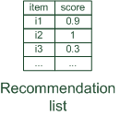
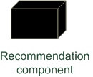
Paradigms of recommender systems
Recommender systems reduce information overload by estimating relevance

Slide 6


Paradigms of recommender systems
Personalized recommendations

Slide 7

Paradigms of recommender systems
Collaborative: "Tell me what's popular among my peers"

Slide 8
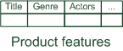
Paradigms of recommender systems
Content-based: "Show me more of the same what I've liked"

Slide 9

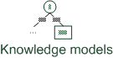
Paradigms of recommender systems
Knowledge-based: "Tell me what fits based on my needs"

Slide 10
Paradigms of recommender systems
Hybrid: combinations of various inputs and/or composition of different mechanism

Slide 11
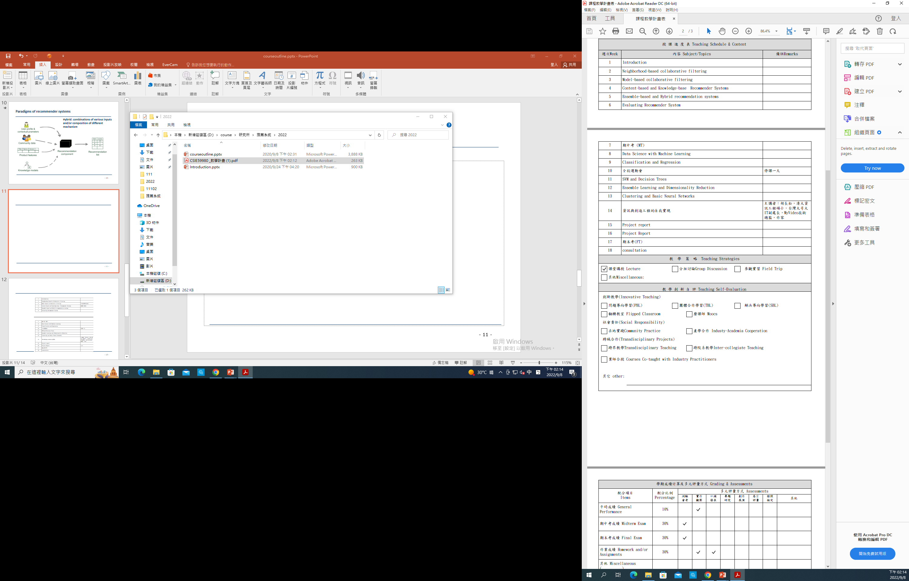
2022/10/26
2023/1/4

Slide 12
